Slide 1
Inclusive Language Commitment
Arm is committed to making the language we use inclusive, meaningful, and respectful. Our goal is to remove and replace non-inclusive language from our vocabulary to reflect our values and represent our global ecosystem.
Arm is working actively with our partners, standards bodies, and the wider ecosystem to adopt a consistent approach to the use of inclusive language and to eradicate and replace offensive terms. We recognise that this will take time. This course contains references to non-inclusive language; it will be updated with newer terms as those terms are agreed and ratified with the wider community. We recognise that some of you will be accustomed to using the previous terms and may not immediately recognise their replacements. Please refer to the following examples:
When introducing the AMBA AHB Protocols, we will use the term ‘Manager’ instead of ‘Master’ and ‘Subordinate’ instead of ‘Slave’.
Contact us at education@arm.com with questions or comments about this course. You can also report non-inclusive and offensive terminology usage in Arm content at terms@arm.com.

Slide 2
Introduction to the Internet of Things
Notes:
In this course, we will learn about the Internet of Things (IoT) technology, starting with an introduction to the IoT paradigm, then discussing IoT system architectures and standardization efforts. We will then examine the specifics of embedded systems, hardware platforms for IoT, and in particular the Arm Cortex-M4 processor architecture. We will study interrupts and low power features and understand how we can harness the Mbed platform to develop IoT applications. We will continue our journey overviewing different connectivity solutions and cloud computing concepts that power IoT. We will then dive into security aspects specific to IoT and finish with a discussion about future trends.

Slide 3
Syllabus
This module introduces the Internet of Things (IoT) technology, covering
The meaning of IoT
A brief history of IoT
Technologies that enable the IoT paradigm
The technical challenges facing IoT ecosystems
Opportunities and potential applications
Notes:
In this module, we will define the IoT concept, understand what led to its emergence, and overview recent technology advances that make the IoT paradigm possible. We will also discuss the key challenges that must be addressed in order to build IoT systems. Finally, we will examine the opportunities IoT brings in different application domains.

Slide 4
What is IoT?
Internet of Things (IoT) refers to a large ecosystem of devices and smart objects that can gather, exchange, and act on information over networking infrastructure.
These “things” include:
Home appliances, e.g., washing machines, fridges, kettles, vacuum cleaners, light bulbs, thermostats, door locks, and video cameras
Civil engineering structures, e.g., bridges and railways
Wearable devices, e.g., smart watches, smart glasses, rings, and clothes
Entertainment devices, e.g., TVs, game consoles, and toys
Biomedical devices, e.g., pacemakers, blood pressure monitors, digital pills
And conceivably any THING in the world
Notes:
The IoT refers to a rich ecosystem of physical objects that gather information about the surrounding environment and transmit this (possibly after local processing) to other devices or cloud-based platforms, by means of a networking fabric. In turn, applications that are fed with the data collected compute statistics that can be used subsequently to remotely control certain devices (e.g., actuators), automate certain processes, predict the next state of a system, or synthesize information to user, to help in decision making.
The term “things” in IoT refers to a wide range of items. These items might include health monitors, environmental monitors, connected cars, streetlights, systems that could assist soldiers on a battlefield, or firefighters during a search and rescue operation.

Slide 5
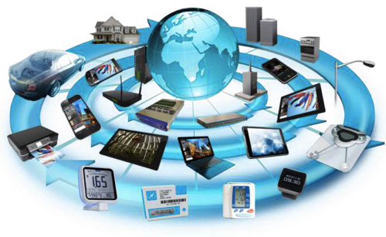
How does an object become part of the IoT family?
Objects that make up the IoT typically have the following properties:
They incorporate computing hardware with small form-factor
Have (multiple) sensing and/or actuation capabilities
Often have low-power consumption and can be battery-powered
Usually transmit and receive information wirelessly
They are connected to the Internet and may be uniquely addressable
Their functionality can be (re)programmed
May be able to operate autonomously without human interaction
Notes:
A number of features distinguish IoT devices from other physical entities that may be part of a digital system or process. By and large, smart objects rely on a hardware platform that has small form-factor and often spatialized computing capabilities. We refer to this as an embedded system. One or multiple sensors and/or actuators are connected to such systems. Sensors detect changes in a particular property of the surrounding environment and convert these into a digital signal, while actuators convert a signal into a control action.
IoT devices are frequently battery-powered and therefore the energy consumed during operation is kept to a minimum.
The information collected can be exchanged locally among devices to achieve a given task or is transmitted to a remote location for further processing. Such communication is usually wireless, thus does not rely on physical infrastructure. IoT devices are further connected to the Internet and may have a unique identifier that makes them reachable from any remote location.
A distinct feature of IoT objects is also the fact that they may be (re)programmed to extend their originally intended functionality, fix a bug discovered after production, or even change their behavior completely.
In addition, some IoT device may be able to operate autonomously, requiring no or minimal user control, for instance smart home heating, ventilation, and air conditioning systems (HVACs) that, once configured, monitor the climate of a room and start/stop a heating unit when the temperature observed exceeds certain thresholds.

Slide 6
The history of IoT
1988
Mark Weiser (Xerox PARC) – Ubiquitous Computing
“…hundreds of wireless computing devices per person per office, of all scales […] This is different from PDA’s, dynabooks, or information at your fingertips. It is invisible, everywhere computing that does not live on a personal device of any sort, but is in the woodwork everywhere. […] its highest ideal is to make a computer so imbedded, so fitting, so natural, that we use it without even thinking about it.”
Weiser, M. (1988). What Ubiquitous Computing Isn’t.
Notes:
The Internet of Things is not an entirely new concept, but more of a computing philosophy that has evolved over time. Not long after personal computers became mainstream technology and the precursors of today’s tablet PCs (personal digital assistants – PDAs, dynabooks) were emerging in the 1980s, industry researchers had the vision of “ubiquitous computing”, i.e., an ecosystem where computing would be pervasive and act on information seamlessly.

Slide 7
The history of IoT
1988
1999-2002
Neil Gershenfeld (MIT Media Lab)
“in retrospect it looks like the rapid growth of the World Wide Web may have been just the trigger charge that is now setting off the real explosion, as things start to use the Net.”
Kevin Ashton (Auto-ID @ MIT) – Internet of Things
“We need an internet for things, a standardized way for computers to understand the real world.”
Ghershenfeld, N. (1999). When Things Start to Think.
Forbes (2002). The internet of things.
Notes:
After the World Wide Web (WWW) became public in the 1980 and the main method for people to exchange information over the Internet, various researchers began to envision the possibility of devices other than computers to connect to the Internet and recognize the need for standardization that would allow computers and devices to sense the environment and speak the same language among each other.

Slide 8
The history of IoT
1988
1999-2002
2005
International Telecommunications Union (ITU) Internet Report: The Internet of Things
“always on communications, in which new ubiquitous technologies (such as radio-frequency identification and sensors) promise a world of networked and interconnected devices (e.g. fridge, television, vehicle, garage door, etc.) that provide relevant content and information whatever the location of the user – heralding the dawn of a new era, one in which the internet (of data and people) acquires a new dimension to become an Internet of Things.”
ITU (2005). ITU Internet Reports 2005: The Internet of Things.
Notes:
A few year later, the International Telecommunications Union (ITU) published a report that outlined the IoT vision in greater detail, whereby a range of wireless connectivity options enable traditional consumer devices (including TVs, fridges, cars, etc.) to communicate and be controlled by users, regardless of their location.

Slide 9
The history of IoT
1988
1999-2002
2005
2009
European Commission,
IoT — An action plan for Europe
“network of interconnected objects, from books to cars, from electrical appliances to food […]. These objects will sometimes have their own Internet Protocol addresses, be embedded in complex systems and use sensors to obtain information from their environment […] and/or use actuators to interact with it.”
Commission of the European Communities (2009). Internet of Things — An action plan for Europe
Notes:
The opportunities were later recognized by the European Commission, who gave a much broader scope to the IoT definition, encompassing virtually any type of object having Internet Protocol (IP) addresses and hence being reachable over the Internet. For the first time the possibility of “closing the loop” is clearly articulated, as the “IoT – An action plan for Europe” specifically mentions actuators and the ability of objects to interact with the environment.

Slide 10
The history of IoT
1988
1999-2002
2005
2009
2012
Cisco coins Internet of Everything
“The Internet of Everything (IoE) brings together people, processes, data, and things to make networked connections more relevant and valuable than ever before – turning information into actions that create new capabilities, richer experiences, and unprecedented economic opportunity for businesses, individuals, and countries.”
Evans, D. (2012). The Internet of Everything: How More Relevant and Valuable Connections Will Change the World
Notes:
More recently, Cisco added data and human dimensions to the IoT definition, articulating an even broader concept, that of “Internet of Everything,” that would open up new experiences and opportunities for businesses and people.

Slide 11
From embedded systems to IoT
IoT can be seen as an evolution of wireless sensor networks, where the network is no longer dedicated to a single application.
Instead IoT provides a platform that can accommodate a range of applications and devices that are easier to manage.
Like in the ubiquitous computing paradigm, IoT devices operate seamlessly, but in addition
they are connected to the Internet,
have more functionality, and
are more intelligent.
Arm envisions 1 trillion Internet-connected devices by 2035
Notes:
Embedded systems have played an essential part in the evolution of IoT.
Unlike their wireless sensor network precursors, where interconnected devices collect one type of data exclusively (e.g., temperature, humidity, dust, luminance, etc.), IoT offers a platform that can serve multiple applications simultaneously, enabling to exchange and fuse information of different types, depending on the context. Smart devices are also easier to reconfigure and manage over the network, for e.g., through over-the-air updates.
Aligned with the goals of ubiquitous computing, IoT seeks to make people’s lives and jobs easier, while being invisible. In addition, Internet connectivity is a key ingredient in IoT that enables to exchange and analyze meaningful data beyond proximity boundaries, thus becoming more intelligent and more functional. Based on the analysis of this data, other devices can make adjustments, for e.g., a farm irrigation system can be operated using data from a humidity sensors without user input.
Scale is also a crucial characteristic of IoT, as it encompasses extremely large numbers of devices.

Slide 12
Technologies that enable IoT
Mobile computing:
Faster, cheaper, low-power processors and devices (e.g., smartphones and tablets)
Little devices and more sensing options:
Wearables and rich data sources
Big data and the cloud:
Cloud-computing services to process data from sensors
Notes:
Let’s now take a look at the techniques that have enabled IoT.
To begin with, advances in mobile computing led to processors and devices that have relatively high computing power, while consuming little energy and thus being able to operate without mains power supply for longer. Such devices include smartphones and tablets that frequently act as mediators between embedded systems and cloud infrastructure in IoT ecosystems.
Improved manufacturing techniques allow for production of smaller computing hardware and richer sensing modalities, while at the same time, reducing production costs. As a result, affordable devices now exist that send infrequent small messages (little data) to the cloud and/or to other devices. This is the case of wearables, car monitoring systems, and home appliances.
Collectively, the plethora of IoT devices will collect enormous amounts of data that is referred to as big data. Storage and processing such vast amounts of data requires substantial additional computing infrastructure. Many companies do not have the budget to acquire and maintain dedicated servers that can handle these tasks; therefore they rely on cloud-based services that can perform a range of functions on an “as needed” basis.

Slide 13
Technologies that enable IoT
Better batteries:
E.g., lithium-ion polymer – more energy storage, rapid charging
Faster and more diverse standardized connectivity options:
Short-range (Bluetooth, Zigbee), medium-range (Wi-Fi, cellular), and long-range (LoRa, SigFox)
Development resources:
APIs and protocols (REST, MQTT), language-independent data formats (e.g., JSON), development communities (Mbed)
Notes:
Advances in energy storage is another key enabler for IoT, e.g., small lithium-ion polymer batteries, as they enable devices to operate without charging or battery replacement for long periods of time.
Various communications standards have been developed over the recent years as well that allow different devices to talk to each other wirelessly. Efforts have been made to keep message and signaling overheads low, to enable more efficient communications. Several connectivity options exist to suit the scope of different applications. For instance, short-range protocols such as Bluetooth and Zigbee are preferred in wearable and home automation systems, while medium-range solutions are preferred when data rich content must be transferred (e.g., video streaming over Wi-Fi) or strict latency requirements must be met (e.g., fire alarm systems using cellular technology). In contrast, long-range wireless technologies such as LoRa are preferred for applications such as smart agriculture, where monitoring is performed over large areas and messaging is infrequent and less sensitive to packet loss.
Nevertheless, IoT has been made possible by the ever expanding number of resources available to developers, including standardized programming interfaces (APIs) and messaging protocols such as Message Queuing Telemetry Transport (MQTT) that enables rapid integration with the cloud. The emergence of language-independent data formats, e.g., the JavaScript Object Notation, makes interconnecting different types of systems much easier. Building on these, development communities, such as the Arm Mbed ecosystem, enable developers to create trusted applications.

Slide 14


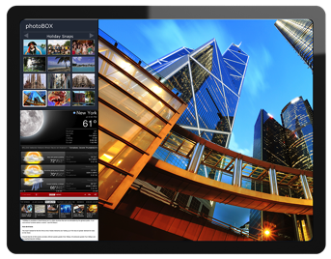
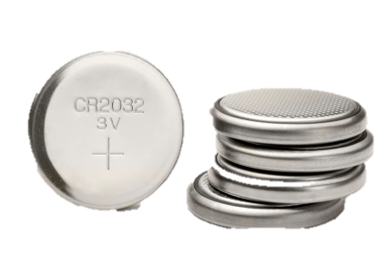
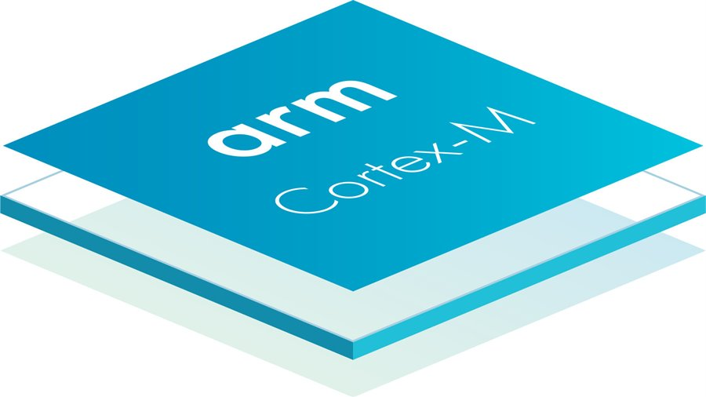
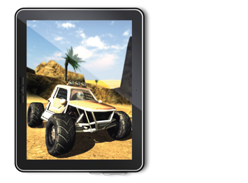

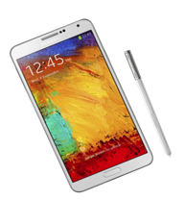
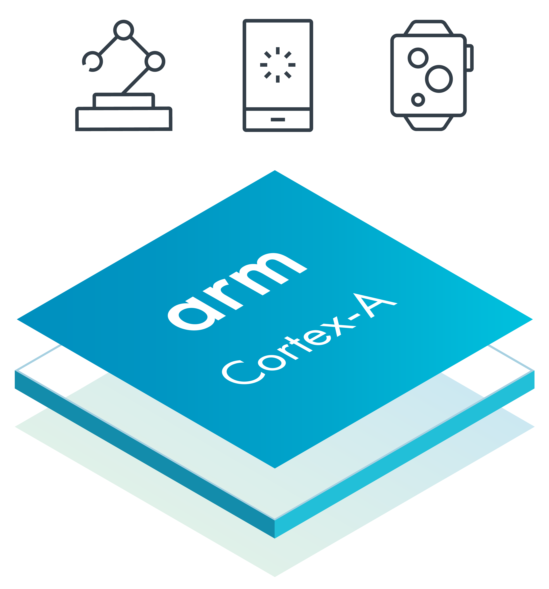
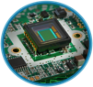
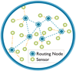
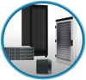


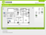




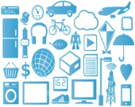



Technologies that enable IoT
Mobile computing
Little devices and more sensors/Big data and the cloud
IoT
Devices
Applications
Big Data
Cloud and community-based development
IEEE 802.15.4
1,000,000s
Platform
LTE
Networking standards that enable scalability
Notes:
Here are some examples of the technologies in some of these categories. We will describe them in the following slides.

Slide 15
Technologies that enable IoT
Mobile computing
IoT
Notes:
Mobile computing technology is not limited to mobile phones. Any other mobile device with comparable computing power falls under this category (for e.g., a car infotainment system, a virtual reality headset, smart-home gateways, etc.).
Arm’s Cortex-A family of processors is well suited for such devices. This is because these processors offer substantial computing power while bearing low energy consumption, both of which are vital for mobile devices.
It should be noted that, of course, mobile devices must run some kind of an operating system (OS). Currently the most popular ones in the field are Android and iOS, although there are alternatives such as the Ubuntu open source software platform.

Slide 16
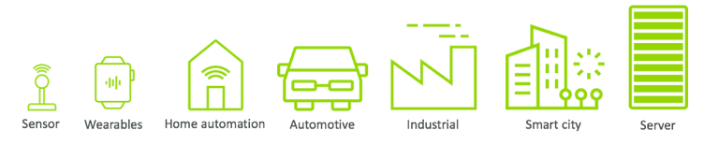
The Arm architecture across IoT: From sensor to server
Arm Cortex-A family
Application processors for feature-rich operating systems (OSes) and 3rd party applications
Arm Cortex-R family
Embedded processors for real-time signal processing and control applications
Arm Cortex-M family
Microcontroller-oriented processors application specific or system on chip (Soc) applications
Notes:
Arm’s processor technology covers IoT applications from sensors to servers:
As mentioned earlier, Arm Cortex-A Processor Series are usually used in a range of devices undertaking high level of data processing and complex compute tasks, including machine learning at the edge, autonomous context-based decision making, or securely connecting IoT devices to the cloud (gateways).
The Arm Cortex-R Processor Series meets the high-performance, very low-latency, and low-power requirements of applications such as connected cars, high-end cameras, or disk drive controllers.
Cortex-M Processors provide the smallest/lowest power computing solutions that are appropriate for sensors, basic wearables, and asset tracking devices, that are battery powered or/and operated in remote locations.
Arm TrustZone Technology introduces hardware isolation with non-secure software blocked from directly accessing secure resources.

Slide 17
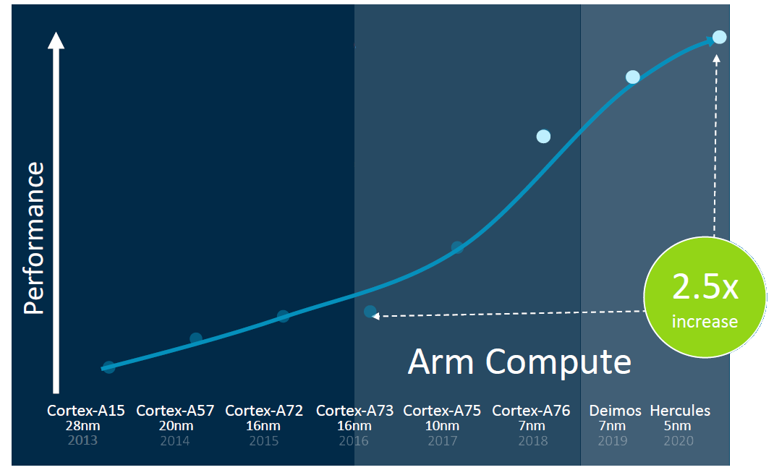
Arm Cortex-A class processors
The performance of Cortex-A processors has increased dramatically over the past 5 years
Delivers an interactive media and graphics experience
Notes:
The latest Arm Deimos and Hercules architectures are challenging the performance of market competing architectures across the entire compute spectrum, from embedded devices to servers, at a much reduced power consumption.

Slide 18
Technologies that enable IoT
Little devices and more sensors/Big data and the cloud
IoT
Devices
Applications
Big Data
Notes:
Another enabler of IoT that we mentioned is the reduced cost of manufacturing small devices that are designed to collect and transmit small amounts of data. At the same time, as the number of little devices explodes in the IoT ecosystem, the total amount of data generated becomes very large. This is where cloud computing (that can handle big data) comes in.

Slide 19

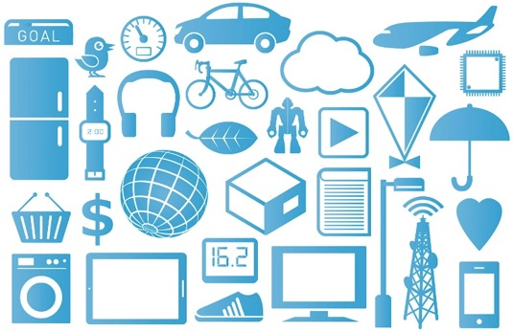
Little devices and sensing (little data)
LTE
IEEE 802.15.4
Nodes
Security
Data Storage & Analytics
Communication
Management
Local
processing
Discovery
Applications
Nodes
Little Data
Big Data
Notes:
Delving deeper into the flow of information, we can distinguish different types of IoT architectures that can be employed to interconnect network nodes (which we will discuss in the next module), with the goal of moving the data from the network edge (devices) to the cloud (servers), where it can be stored and processed. In all scenarios, small sensors and actuators reside within the edge node that are usually small embedded devices powered, for e.g., by Arm’s Cortex-M family of processors. Physically, these devices can be anywhere around homes, in the city, or even out in the field on huge farms. As such, a wireless communication protocol is preferred to a wired connection when transmitting the data from the edge to the cloud. Depending on the application domain, cellular networking technology (e.g., LTE), Bluetooth, Wi-Fi, or other wireless standards are employed. Each one of these has advantages and disadvantages, as we will discuss in more detail later. Regardless of the wireless technology employed, power consumption and data security are always important factors in IoT.
At the other end-point of the network, servers (usually in the cloud) are responsible for processing all the big data collected from sensors and, where appropriate, sending commands to act on the information synthesized. Possible actions include pushing notifications to users and sending commands to actuators in an IoT process. Also, in addition to providing insightful analytics to the user, based on the data collected, servers can also run specific applications (for example, heating control in homes).

Slide 20
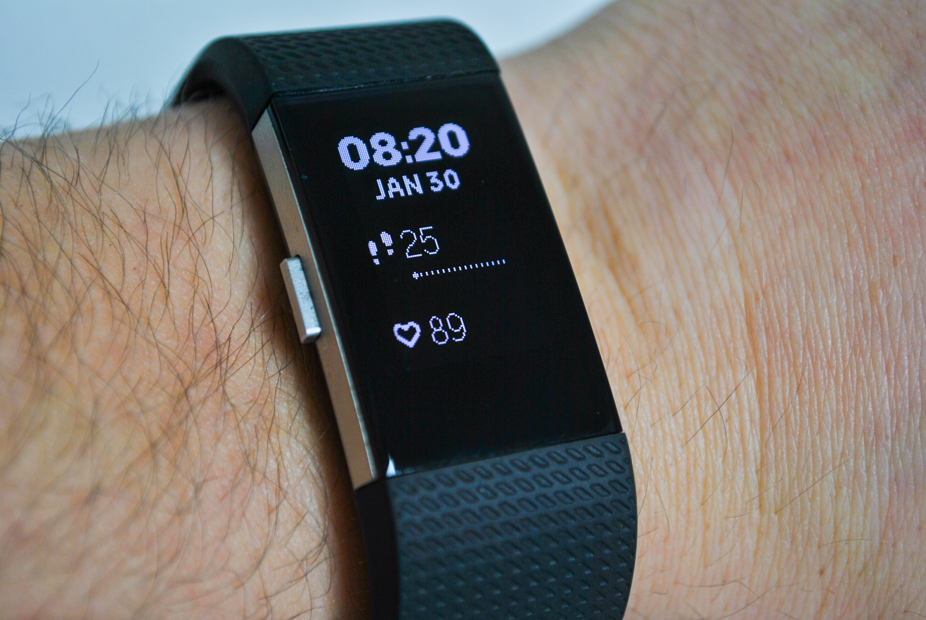

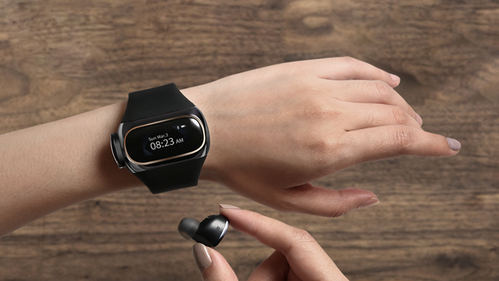
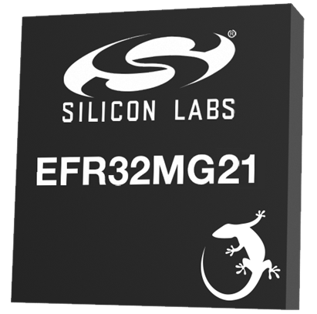
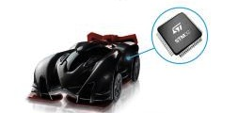
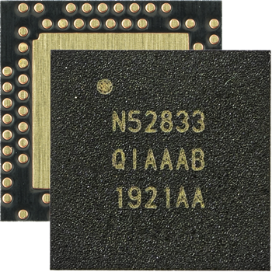


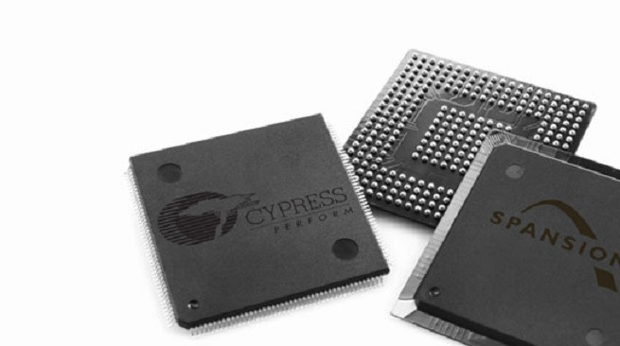
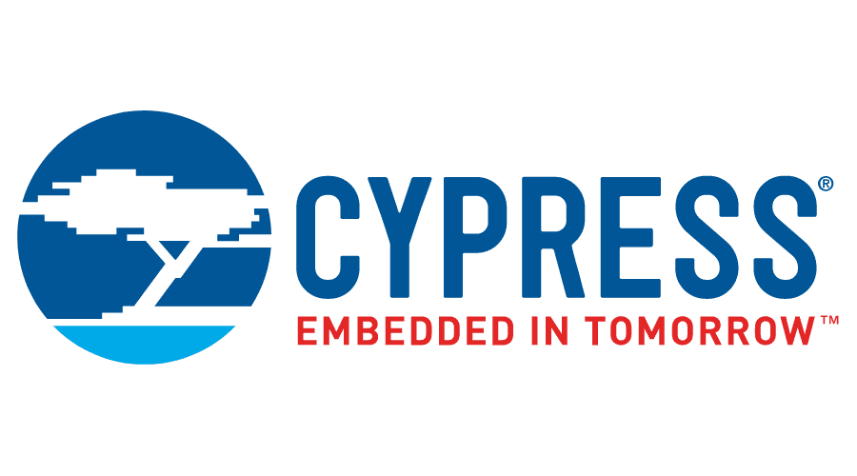
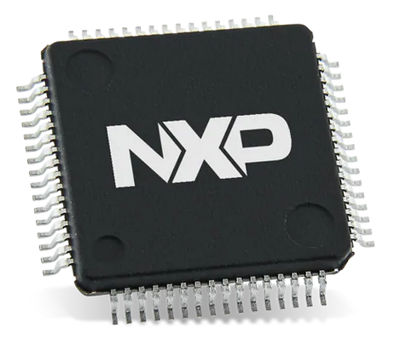

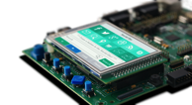
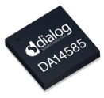
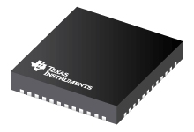


Arm Cortex-M: Enabling little devices
>45bn
Arm Cortex-M chips shipped to date worldwide
Wearable
Fitbit - 18M devices sold in 2018
7,645 backers pledged $822,869
Wearable
Airpower - Wearbuds
Nordic Semi nRF52833
Bluetooth 5.1 & Zigbee
Arm Cortex-M4 Processor
Silicon Labs EFR32MG21
Multiprotocol wireless SoC
Arm Cortex-M33 Processor
Cypress CYW43438
WiFi + Bluetooth 4.2
Arm Cortex-M3 Processor
NXP K32
Industrial and IoT applications
Arm Cortex-M0+/M4 Processor
Toys
Anki
Dialog Semiconductor DA14585 Bluetooth 5.0 SoC w/Audio
Arm Cortex-M0 Processor
TI CC2650
BT/ZigBee/6LoWPAN
Arm Cortex-M3/M0 Processor
Embedded Java
MICROEJ
Notes:
Arm’s Cortex-M family is specifically targeting small low-power embedded devices frequently encountered at the edge.
In recent years, many more than 45bn wearable and smart devices running on the Cortex-M processors have reached consumers. Some examples are listed on this slide.
The main aims of the Cortex-M processors are (1) keeping high energy efficiency that in turn means lower energy costs and longer battery life; (2) smaller physical size that means lower silicon costs and lower chip costs; and (3) ease of use that means faster software development and code reuse. This is good not only for manufacturers and developers, but also for consumers, as smart devices become cheaper and more functional.
Cortex-M processors are used in applications such as smart metering, fitness trackers, automotive and industrial control systems, white goods, medical instrumentation, and many more.

Slide 21
Technologies that enable IoT
IoT
IEEE 802.15.4
LTE
Networking standards that enable scalability
Notes:
We will also have a look at some of the networking standards and network technologies that are enabling IoT.

Slide 22
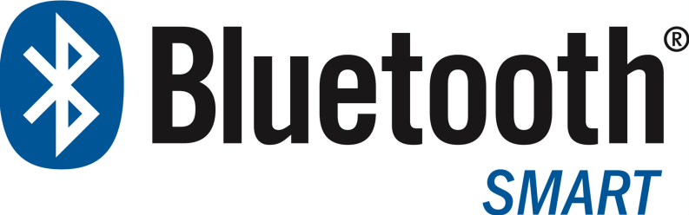
Bluetooth Low Energy (BLE) connectivity
Ultra low power, designed to run with coin cells, e.g., 10mW
Short range communication, e.g., < 100 meters
Powering small IoT devices, e.g., wearables
Proximity sensing/inventory tracking (BLE beacons)
Many-to-many communications (mesh networking), e.g. building automation
Notes:
One of the most popular wireless technologies that power IoT devices is Bluetooth Low Energy (also known as Bluetooth Smart). This is a revised version of Bluetooth that was specifically designed to be used in ultra low-power devices that can run for over a year using a cell-coin battery (~ 10mW).
Specifically, energy efficiency is due to the low transmission power employed for short communication ranges (below 100 meters) combined with the low connection overheads, short transmission windows, and the stateless operation of the protocol. The main drawback is that only very small data packets can be sent that is however sufficient for wearable applications, proximity sensing, or inventory tracking in industrial applications. The latest revision of the Bluetooth standards introduces new features that can be exploited in the IoT scenarios, such as many-to-many communication that is necessary in building automation.

Slide 23
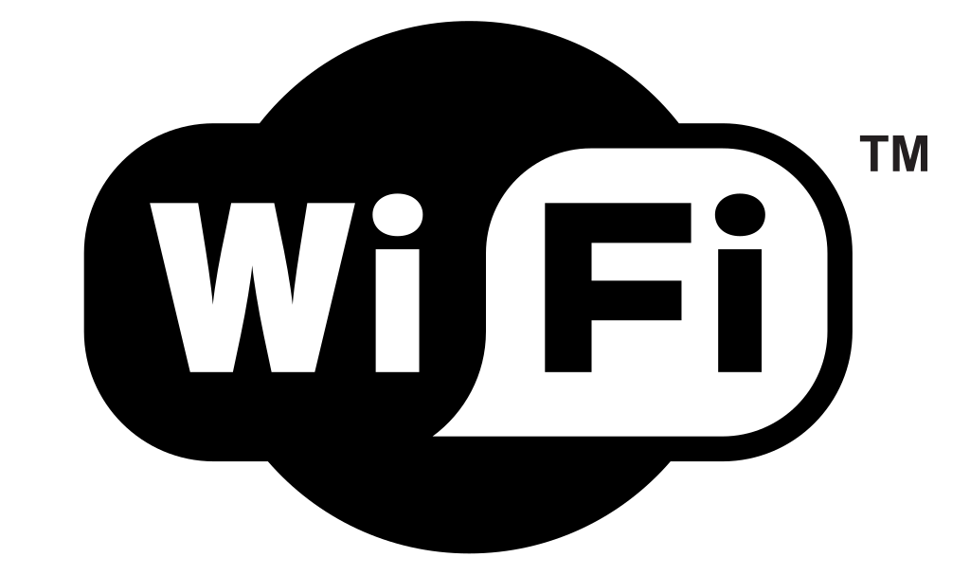
Wi-Fi connectivity
Longer communication range
Uses unlicensed spectrum and simple decentralized channel access protocol → easy to deploy
Higher throughput supported
Particularly suitable for devices with less stringent power constraints, e.g., smart home appliances
Power-saving mode (PSM) also defined to save energy in battery-powered devices
Notes:
One alternative to Bluetooth is the Wi-Fi technologies that bundles together the IEEE 802.11 family of standards. This provides higher throughput as the channels used have large bandwidth and different performance enhancement have been developed over the year to reduce communications overhead, as we will discuss in a future module.
Wi-Fi is particularly well-suited to mains powered devices, but some wireless routers that manage connectivity can also support operation with devices that employ a power-saving mode, whereby they periodically switch off their wireless transceiver to save energy. In such cases, the router is expected to buffer the packets that must be sent to a device, until this comes online.

Slide 24
Technologies that enable IoT
IoT
Cloud and community-based development
1,000,000s
Platform
Notes:
Another enabler of IoT is the substantial development resources that have emerged in recent years, including the Mbed platform used for easy prototyping and development of applications and systems that employ Arm Cortex-M-based microcontrollers. This includes open software libraries, open hardware designs, and open online tools for professional rapid prototyping of products on Arm-based microcontrollers.

Slide 25


Cloud and community-based development
Arm Mbed: Accelerating IoT deployment
Rapid, professional IoT device development
An open source platform and libraries for Cortex -M microcontrollers
Mix and match essential components for your product design
Microcontrollers, radios, sensors, and software stacks
Bluetooth, 802.15.4/6LoWPAN, WiFi, and cellular
Simplify integration with cloud services
Integration with Arm Pelion IoT platform
Embedded agents and APIs for cloud services
MCUs
Radios
Sensors
Notes:
Mbed helps to accelerate the development of IoT devices by providing a C/C++ Software Development Kit (SDK), a microcontroller Hardware Development Kit (HDK), and an Integrated Development Environment (IDE), including an online compiler and online developer collaboration tools. The platforms allow combining different type of microcontrollers, sensors, wireless technologies, and software stacks, so as to best meet the requirements of specific applications.
At the same time, it enables easy integration of IoT prototypes with cloud services and effective management via the Arm Pelion IoT platform.

Slide 26
Challenges facing IoT
Interconnecting many devices that exchange (big) data can be challenging
Better hardware and code that runs efficiently.
Aggregating large data sets and acting on it in real-time.
Modeling and predicting the behavior of complex systems.
Ensuring reliable connectivity and scalability.
Guaranteeing secure operation and data confidentiality
Ensuring energy efficient operation.
Developing easy to use products and services
Complying with regulations
Notes:
These enablers aside, there are many challenges to overcome before an IoT world can be fully realized.
Such challenges faced by the IoT community are in the areas of chip production. As more and smaller devices require chips, chip manufacturing prices need to continue to go down, and chips need to become smaller too. Code development must also be aware of the resource constraints of embedded devices. At the same time, data centers and servers must adapt to cope with the huge amounts of data being sent back from these devices, not only to store this data, but also to process it.
Power consumption might decrease as chips become smaller, but battery and charging technologies still have to advance in order to lengthen battery life and reliably ensure long operating periods.
Cloud services must be able to handle large data volumes, process it, and make decisions based on real-time. All of this calls for more computing power.
As systems become increasingly complex, real-time decision is often only possible if their behavior can be predicted that in turn often requires accurate system modeling.
IoT further relies on network connectivity to be able to operate. Therefore, the underlying networking fabric must be reliable (i.e., have reduced packet loss and bounded latency). As the number of Internet-connected devices grows, scalability issues must also be addressed. For instance smart metering that relies on legacy mobile connectivity needs to assign a cellular number to each device, while the pool of numbers that can be assigned is limited. IPv6 could address this problem, though not all devices might have sufficient resources to run an IPv6 protocol stack.
Given that users rely more and more on IoT technology, it is critical to guarantee that the operation of smart devices cannot be tampered with by malicious actors and only trusted code can run on such devices. Code Signing Certificates address part of this problem, by allowing only authenticated software to be executed. In addition, challenges of user and data confidentiality exist, that is IoT ecosystems must guarantee that personal information cannot be intercepted by unauthorized parties. Data encryption plays an important role in dealing with this challenge.
Given the embedded nature of IoT devices and the limited ways in which users can interact with them (e.g., lack of keyboards, basic/no displays), product designers must also consider socio-technical and demographics aspects, in order to facilitate adoption.
Importantly, more legally-binding regulations for IoT must be developed to ensure user trust.
An even more serious hurdle is data and identity security. All connected devices must provide safe data collection and exchange while maintaining user privacy.
Finally, in order to ensure safer data transactions, standards such as network protocols must be developed. While some new standards are emerging, including LoRaWAN, 6LoWPAN, BLE, Zigbee, and others, none of these standards can accommodate all the needs of an IoT network:
Developing code that runs on embedded devices and ensuring energy efficient operation.
Ensuring reliable connectivity, optimal infrastructure sharing, and scalability.
Guaranteeing secure operation, ease of use, and not compromising user privacy for some utility.
Aggregating large data sets and exploiting only context specific information in real-time.
Modeling and predicting the behavior of complex systems.
Computationally/energy constrained vs. unconstrained devices
Communication type (decentralized vs. scheduled) and range (long vs. short)
User interface (display, keys, touch, voice, gestures)

Slide 27

Example: Wearable specific constraints
Wristband fitness trackers monitoring activity, sleep, heart rate, etc.
Limited memory
Battery powered
Minimal user interface
Short range communication
Bluetooth Low Energy (BLE)
Wireless communication
Risks of eavesdropping, surveillance, etc.
Notes:
Let’s take a look at an IoT application example and see how these challenges materialize. Consider wearable devices for fitness tracking that are designed to monitor the daily activity and sleep patterns of users, as well as other biomarkers in more feature-rich products.
Owing to their small form-factor, such devices have limited memory and thus the code must be very efficient. Often this might mean compromising some features for utility, for e.g., less robust data encryption for the ability to store more activity records. Their operation must be also energy efficient, given that they are powered by tiny batteries. Interaction with such devices must be sufficiently intuitive, despite the limited interface that they present (e.g., sometimes only a basic LED display).
Given their personal use, connectivity can be tackled with low-energy short-range BLE technology. However, due to the inherent broadcast nature of wireless communication, privacy risks emerge that must be addressed. For instance, recent BLE specifications allow for device address randomization, so as to thwart the threat of surveillance.

Slide 28
Tackling IoT challenges
Multiple approaches required
Theoretical perspective: Rigorous models that capture system behavior at different levels of abstraction.
Engineering perspective: Architectural and network challenges posed by large scale, heterogeneous systems with dynamic behavior.
Experience perspective: Understand the principles underpinning human-machine interaction and how IoT shapes society from a socio-technical perspective.
Notes:
Overall, IoT-specific challenges are often inter-related and addressing them requires more than a single approach. The research community must continue to develop models that can capture the behavior of IoT systems at different levels of abstraction.
At the same time, an engineering perspective is needed to tackle these challenges, in particular, as the scale of IoT systems grows and devices diversify. In particular, architectures and networking technologies will likely continue to evolve.
Thirdly, as more systems get deployed, it is important to recognize how humans interact with IoT technology and what are the socio-technical barriers to adoption. It is only based on this experience that the full societal impact of IoT can be realized.

Slide 29
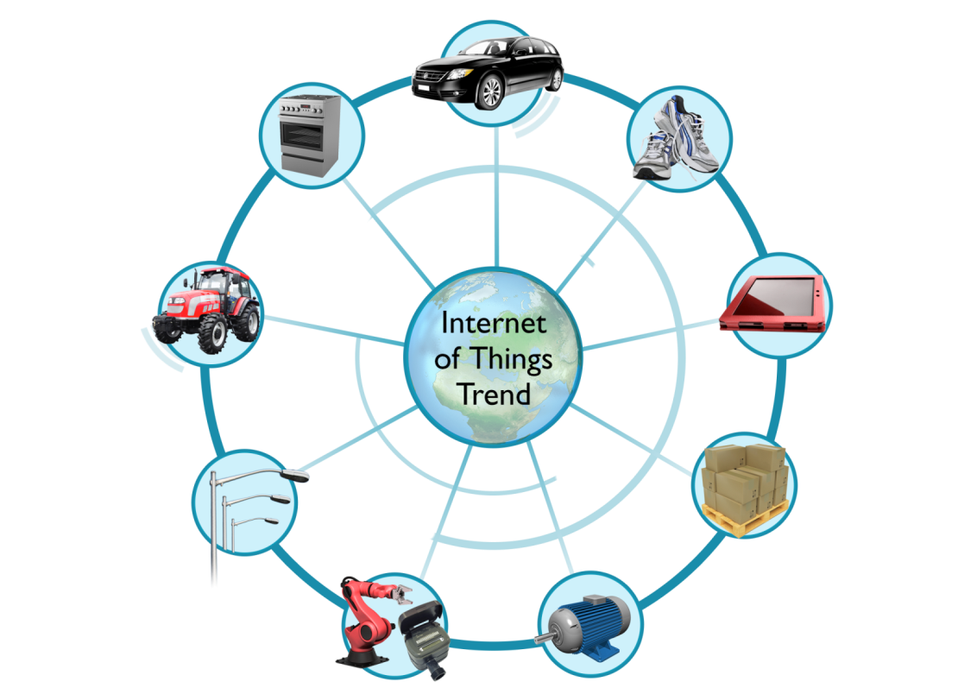
Opportunities
Automotive
Application domains
Industry (manufacturing, transportation, agriculture)
Consumer (smart homes, appliances, assisted living)
Wearables (healthcare, fitness, productivity)
Appliances
Fitness/Healthcare
Portable and Wearable
Electronics
Farming
Lighting
Resource
Management
Manufacturing
Industrial Internet
Notes:
IoT presents a large number of opportunities as virtually any device could have an embedded processor. Some of the big areas for growth include automotive, fitness and healthcare, resource management, manufacturing, lighting, farming, and home appliances. These can be loosely coupled into three main application domains, i.e., industrial, consumer, and wearable.

Slide 30





The IoT opportunity gap
The IoT opportunity is huge
Analysts’ predictions for the number
of connected devices by 2030:
125 billion?
500 billion?
1 trillion?
Reach
Heterogeneous Tech/ Silos of Things
Current trends show strong growth
IoT has been around for about 25 years, but the number of connected things (20bn in 2020) is now increasing faster than the world’s human population (7.7bn in 2020).
Today
Time
Notes:
Undoubtedly, a gap exists between current trends and the opportunities presented by IoT. Today, we have lots of smart devices around us, but most of them do not speak to each other. This situation is referred to as Silos of Things: individual devices are quite smart on their own, but they still require some level of human intervention or a dedicated “bridge” that performs translation between the different protocols with which each technology operates, for them to work together.
Huge growth is predicted in the number of smart devices being used, the number of IoT devices having already surpassed the human population. According to various researchers, by 2030 the total number of connected devices may reach 125bn–1tn.
The “opportunity gap” is the difference between these predicted numbers for IoT growth and current trends for Silo of Things growth. This gap has already begun to close, as various technologies are being developed to enable devices to talk to each other and exchange data.

Slide 31
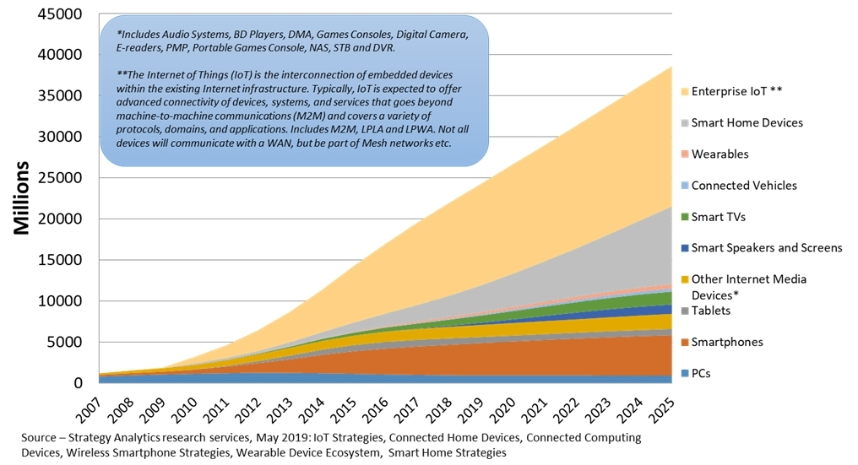
Scale and diversity of IoT is very different to mobile
Notes:
We can see here that the potential IoT market is very different to the smartphone and PC markets in both scale and diversity. The IoT market includes a wide variety of smart devices that can be connected to the Internet. If prices are low, as predicted, the number of IoT devices will be much larger than the number of devices in those other markets.

Slide 32
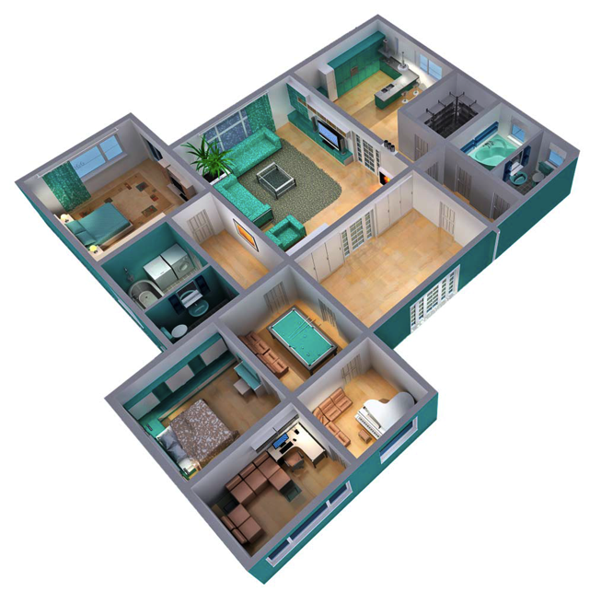
IoT in the home
15 devices per person expected by 2030
Benefits
Risks
Lower home carbon footprint (thermostats, smart metering, smart lighting)
Personalization (voice-controlled personal assistants, access control)
Increased comfort (appliances automation, assisted living robotics)
Safety (smart cameras, smart locks)
Communication is wireless and therefore potentially subject to abuse
Control via software running on phone (app) – risk of malware and privileges abuse
Hijacking and weaponization (e.g., Mirai botnet)
Notes:
Taking a closer look at the home IoT segment, market studies forecast that by 2030 each person will have on average 15 Internet-connected devices, the majority of which will be in the home. These will range from smartphones and TVs to cars; heating, cooling, and lighting systems; and home appliances like fridges, ovens, and dishwashers.
Unfortunately, with convenience also come risks that need to be mitigated. Remember that IoT devices predominantly communicate wirelessly and thus appliances could be subject to personal data exfiltration. In addition, smartphones and tablets will continue to mediate between the smart things and the cloud; therefore the mobile app ecosystem must be defended against malware and software exploits.
The devices themselves must be designed such that they only install trusted software, otherwise the risk of turning IoT devices into botnets that can take down large swathes of the Internet will continue to exist. Such was the case of the Mirai botnet, where IoT devices were maliciously controlled to flood DNS servers with messages, so as to jeopardize their ability to handle genuine name resolution requests. In turns this led to Internet services becoming unavailable and thus to financial losses.

Slide 33
Coming next
Module | Contents
IoT System Architectures and Standards | Key considerations for IoT systems Cloud vs. Edge vs. Fog IoT standards
Introduction to Embedded Systems | What is an embedded system? Examples of embedded systems Features of embedded systems Embedded systems programming
Hardware Platforms for IoT | What is a hardware platform? Types of memory Power saving techniques Types of sensors
Notes:
In the following modules, we will study aspects related to IoT architectures and standards, we will introduce embedded systems, and examine a range of hardware platforms for IoT.

